Slide 1
Cryptocurrency Big Data
Madelyn, Steph, and Abou

Slide 2
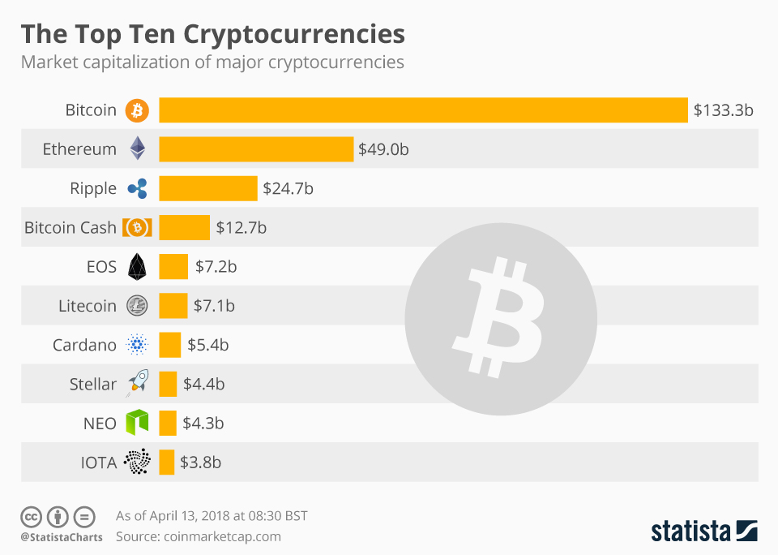
Business Domain: Cryptocurrency
What is Cryptocurrency?
Cryptocurrency is “a digital or virtual currency that is secured by cryptography, which makes it nearly impossible to counterfeit or double-spend. Many cryptocurrencies are decentralized networks based on blockchain technology.”
Blockchain technology is a distributed leger enforced by a disparate network of computers.
A large appeal of cryptocurrency is that they are generally not issued by any central authority, meaning they are basically immune to government interference and manipulation.

Slide 3
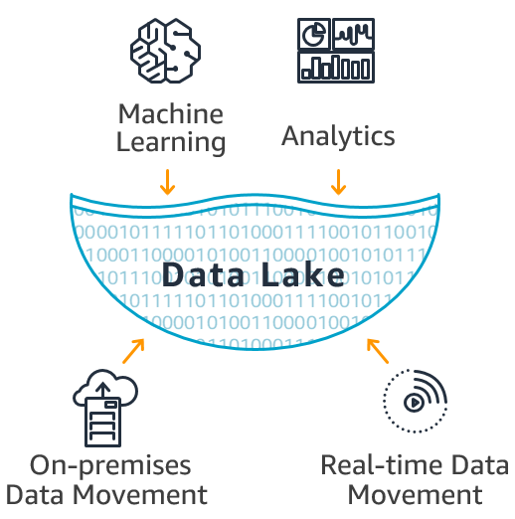
Purpose
The purpose of this project is to create a data lake comprised of cryptocurrency data that can be easily accessed by data scientist, business analyst, and other professionals in a blockchain company.

Slide 4
Business Model
We will be modeling a blockchain company.
Blockchains are distributed databases shared among the nodes of computer networks. Blockchain is a major industry that has created several billion-dollar money making companies.
The current most profitable blockchain company is Coinbase Global Inc. (COIN)
This corporation is a provider of financial infrastructure, like transaction services, and technology created for the crypto economy.
Exchange: Nasdaq
Revenue (trailing 12 months): $5.9 billion
What value will our work bring to the blockchain company?
Our cryptocurrency data will be beneficial to these companies because it will allow them to not only analyze past transactions and identify important patterns, but it will also allow for predictive analytics.

Slide 5
Personas
Business Analysts
Proﬁt optimization and decision making
Data Scientists
Use machine learning to assist on proﬁt maximization and reducing risks for investment.
Use machine learning for trend, pattern from the volatile cryptocurrency market.
Data Engineers
Storing and sharing large volume of data among huge network of participants
Achieve decentralized data management
Network Engineers
Enhance security
Identifying cyber-criminal entities and detecting majority attack
Notes:
A fundamental blockchain architecture for example,the decentralized system contains all the transaction records for every participators and the dataare well structured and accurate, this made it data intensive environment and an ideal resource for applying Big Data analytics

Slide 6
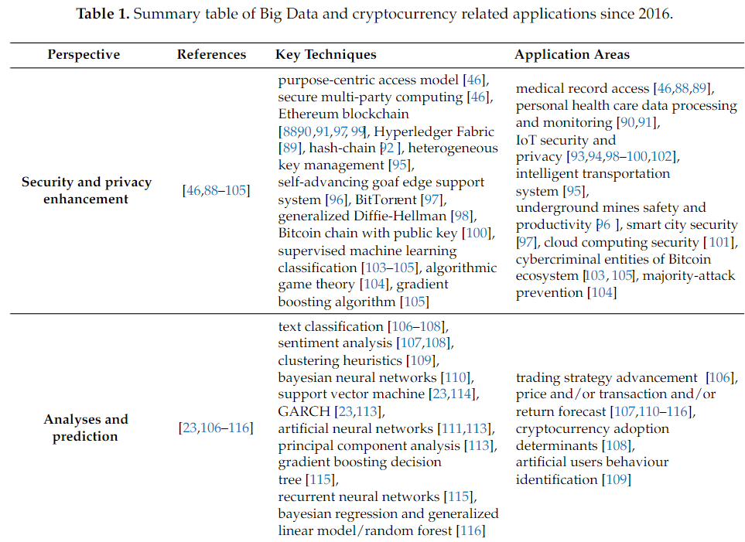
Value
Research Paper

Slide 7
Lifecycle
Accumulation - After a market crash, experienced traders/investors/managers start buying. Valuations look good at this time.
Mark Up - Market is stable, prices are increasing. At the tail end, speculators start returning. Rising prices turn them on.
Top - Hits the mainstream, the general public starts participating.
Distribution - Sellers dominate. Sharp sell-offs and bounces. Prices start dropping.
Markdown - New investors/traders who kept their money in (value fell below investment) lose a lot.

Slide 8
References
https://www.cryptowisser.com/index.php/the-life-cycle-of-cryptocurrency/
https://www.investopedia.com/terms/c/cryptocurrency.asp
https://www.researchgate.net/publication/328407542_Big-Crypto_Big_Data_Blockchain_and_Cryptocurrency

